Slide 1

Electric
CSUN FSAE 2018 - 2019

Slide 2

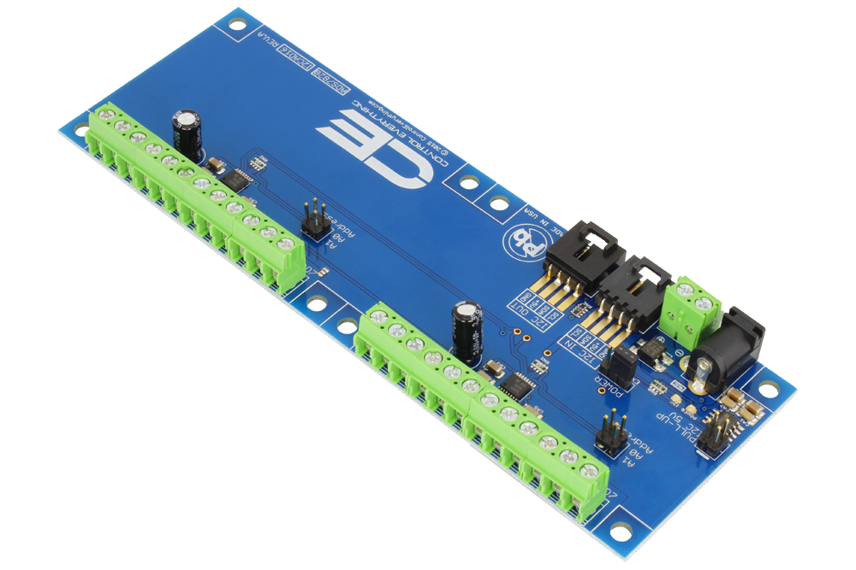
Analog Sensors

Slide 3
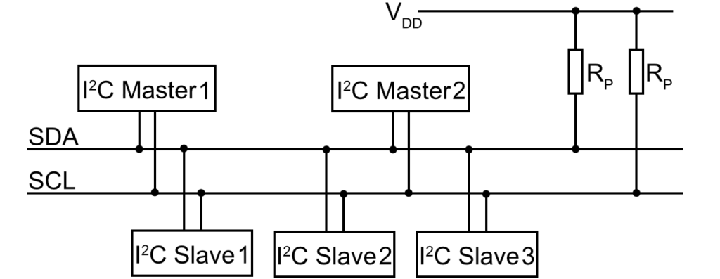
I2C BUS

Slide 4
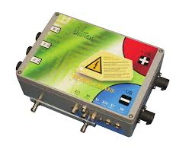
Motor Controller/Battery Management System

Slide 5
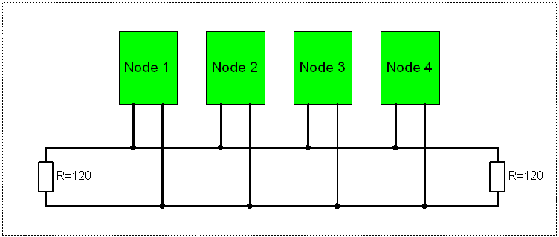
CAN Bus

Slide 6
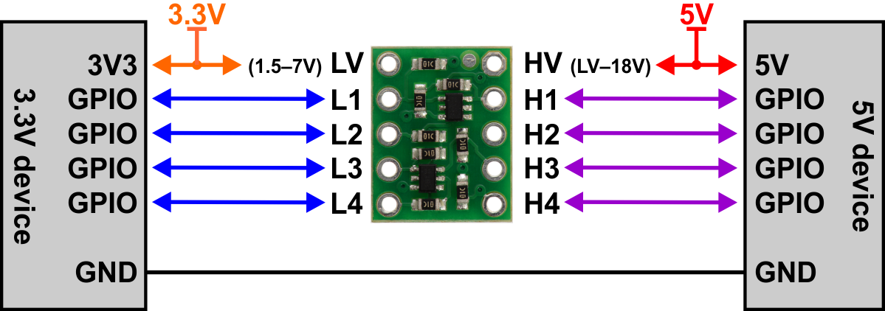
Voltage Differences

Slide 7

Two Way Telemetry
Communication between vehicle and servers
Allows for remote access to vehicle and data
Communicate directly with hardware
Uses Socket.IO and custom front-end to configure the vehicle remotely

Slide 8
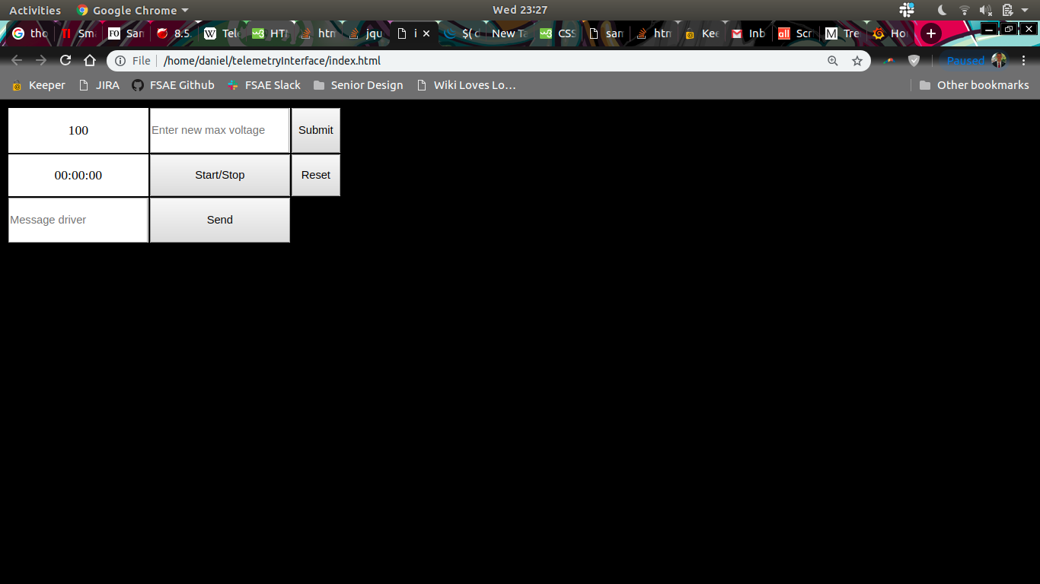
Engineer Telemetry Interface
Interface incorporates
Driver communication
Vehicle modification
Timing abilities

Slide 9
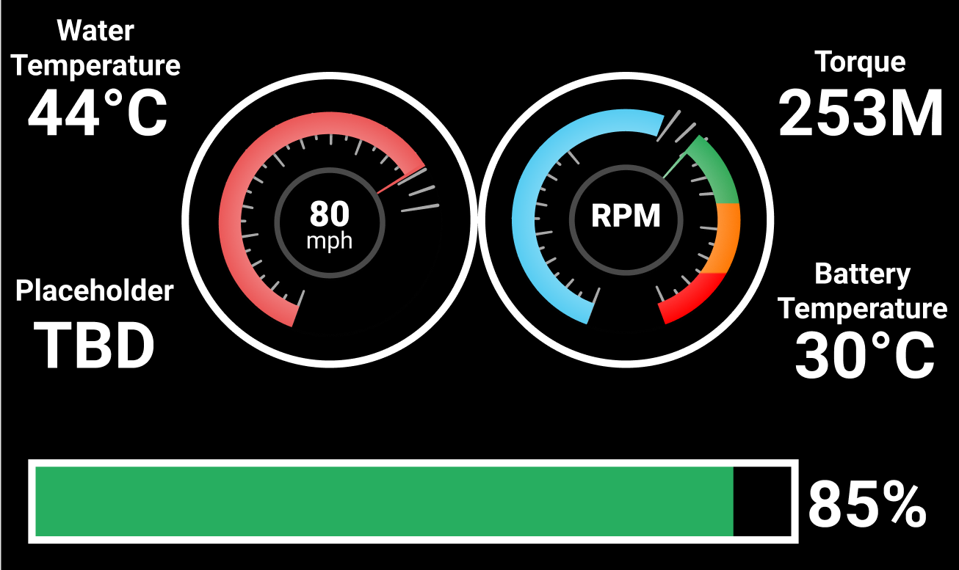
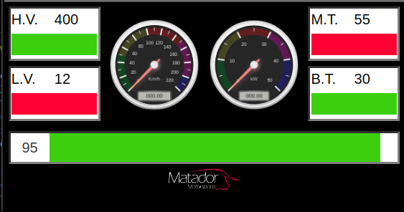
Driver Dashboard
Client Agreed Proposal
Delivered Product - 2/11/19

Slide 10
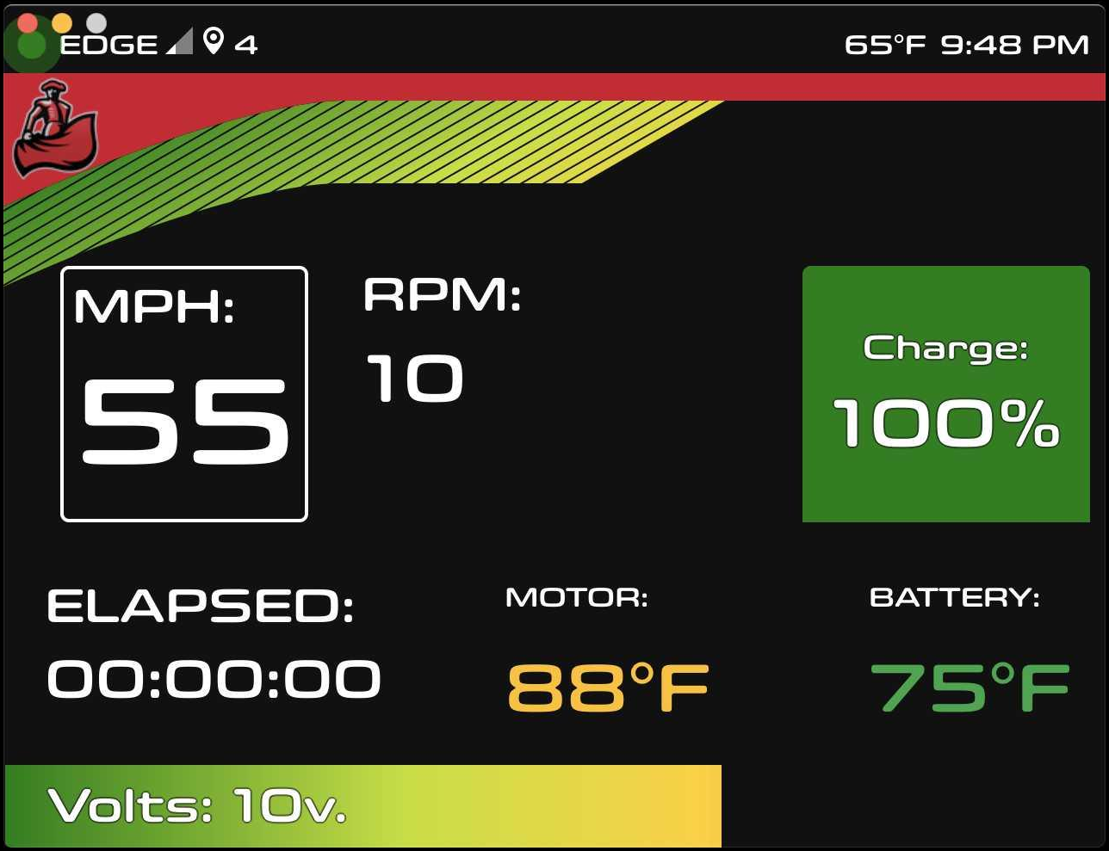
Driver Dashboard
Display real time information to driver
Temperature
Torque
RPM
Battery Power
Easy to read presentation

Slide 11



Live Webcam
USB camera attached to vehicle
Live video of vehicle while driving
Broadcast to Twitch using ffmpeg

Slide 12

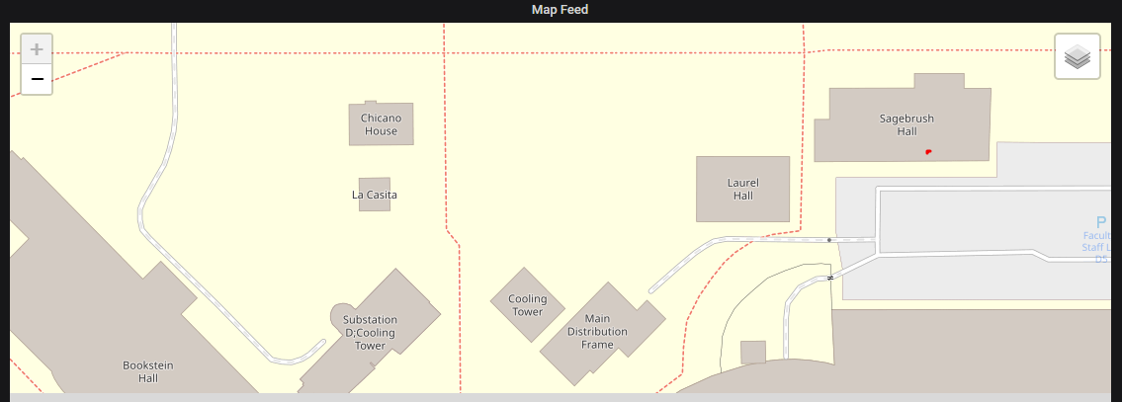
GPS and 4G
Uses GPS data to locate vehicle
Obtains latitude and longitude data
Data points filtered based on number of satellites used to calculate location

Slide 13
Demo

Slide 14
THANKS!

